Slide 1

Strategic Marketing Simulator 1.0 Team Members: Javier Andrial & Jeffrey Carman Product Owner(s): Joseph Cilli Instructor: Masoud Sadjadi School of Computing and Information Sciences Florida International University
Senior Project Final Presentation Fall 2015
December 11, 2015
Notes:
Greet your audience, thank them for attending your presentation, introduce yourself, introduce your project, introduce your team members, and quickly indicate what each of you did in a high-level manner, and put more emphasis on your part/contribution.

Slide 2
Problem definition
The Strategic Marketing Simulator is a means for instructors to engage their students in a hotel market simulation where hotel marketing firms’ decisions have an effect on market share and revenue. Students are able to track their progress and understand how their decisions dictate how the market will the system’s method of reporting.
My main focus in this project has been the student interface with the application and and the end of period algorithm which dictates the results for any given period.
Notes:
Introduce the problem that the whole project tackles and stay focused on the parts that you have been working. Indicate if there is an existing previous system, enumerate its problems/limitations, etc.

Slide 3
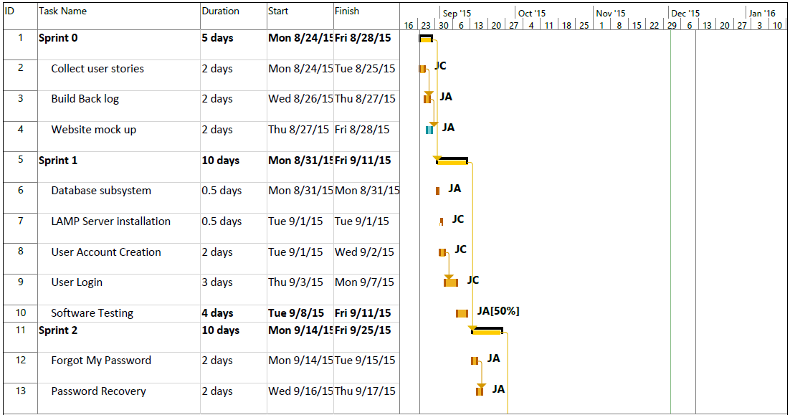
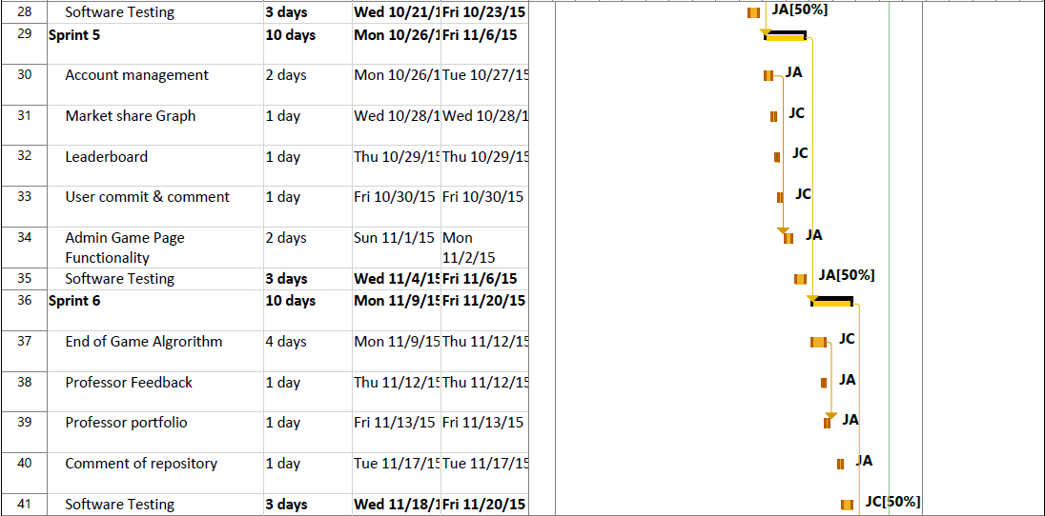
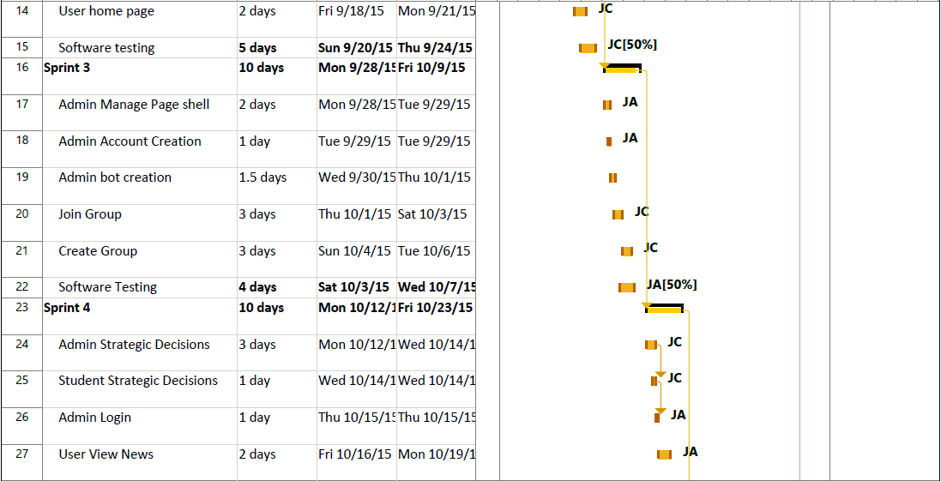
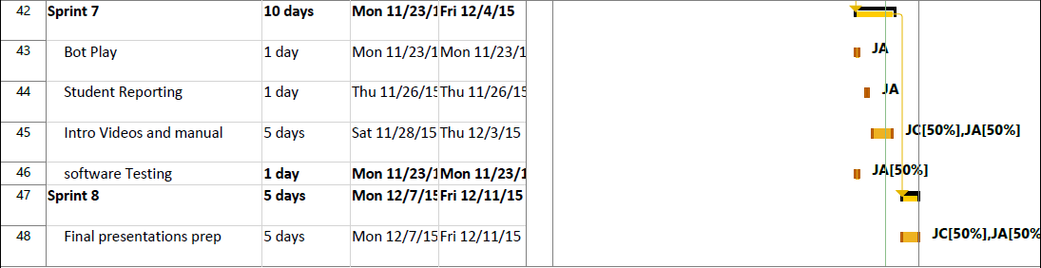
Project Management
Notes:
Project Management (schedule for entire semester) (one slide; Gantt Chart).

Slide 4
Requirements: User Stories
User Story # 776 - Student Create Group
User Story # 769 - Student Join Group
User Story # 669- User login
User Story # 666- Account Creation
User Story # 709 - Admin News
User Story # 712 - User comment and commit
User Story # 678- User strategic decisions
User Story # 810- Admin strategic decisions management.
User Story # 708 - User Scorecard
User Story # 676- User home
Notes:
4. Requirements:
4.1. User stories implemented (one or more slides).
4.2. UML use cases and the use case diagram for the implemented use cases (one or more slides).
4.3. UML sequence diagrams for the implemented use cases.

Slide 5
Requirements: User Stories
User Story # 672- Market Status Graph
User Story #847 - End of Period Algorithm
The End of Period algorithm calculates a group’s impact on the market share and revenue by taking into consideration the positive affects that the strategic decisions, advertising, OTA allocations, and marketing personnel have along with they potentially negative affects that current events from news articles have on their location and market segment chosen at the beginning of the simulation.
Notes:
4. Requirements:
4.1. User stories implemented (one or more slides).
4.2. UML use cases and the use case diagram for the implemented use cases (one or more slides).
4.3. UML sequence diagrams for the implemented use cases.

Slide 6
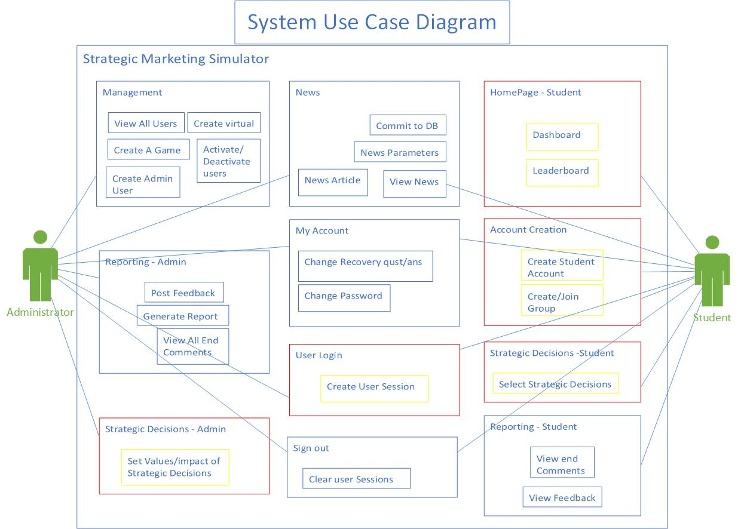
Requirements: Use Cases
Notes:
4. Requirements:
4.1. User stories implemented (one or more slides).
4.2. UML use cases and the use case diagram for the implemented use cases (one or more slides).
4.3. UML sequence diagrams for the implemented use cases.

Slide 7
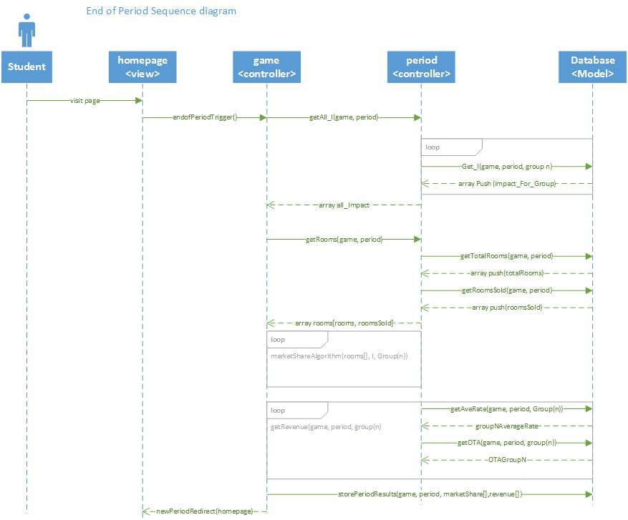
Requirements: Sequence Diagrams
Notes:
4. Requirements:
4.1. User stories implemented (one or more slides).
4.2. UML use cases and the use case diagram for the implemented use cases (one or more slides).
4.3. UML sequence diagrams for the implemented use cases.

Slide 8
System Design: Architecture
The system was designed using the Model View Controller design pattern where the client side views are handling with a web browser and the models and controllers are handling on the back end on an apache server and MariaDB MySQL database(respectively) using PHP.
The system is decomposed into two subsystems:
Main controller which is a collections of controllers which control the flow of data between the models and the views and the database subsystem which is a class that handles all of the reads and writes to the models.
Notes:
5. System design:
5.1. System decomposition; identify the architecture patterns used (one slide).
5.2. System deployment – h/w and s/w requirements (one slide).
5.3. Persistent data design (one slide).
5.4. Security/Privacy (one slide).

Slide 9
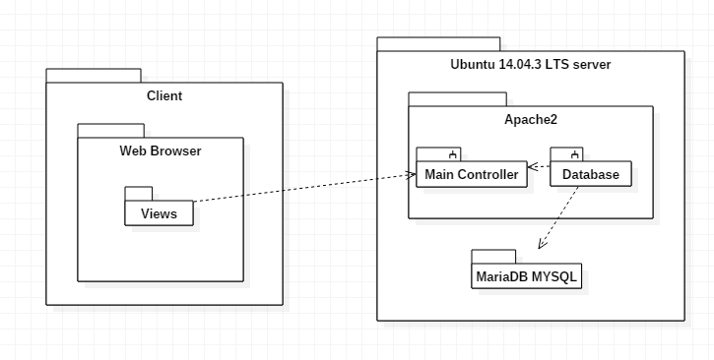
System Design: Deployment
Notes:
5. System design:
5.1. System decomposition; identify the architecture patterns used (one slide).
5.2. System deployment – h/w and s/w requirements (one slide).
5.3. Persistent data design (one slide).
5.4. Security/Privacy (one slide).

Slide 10
System Design
Data is housed in a fully normalized rational MariaDB MySql database using sha256 hashing to protect passwords, secret questions and secret answers.
Sha-256 is a keyless cryptographic hash function with digest length of 256 bits.
All user sessions are cleared upon logout.
Users can be deactivated.
Notes:
5. System design:
5.1. System decomposition; identify the architecture patterns used (one slide).
5.2. System deployment – h/w and s/w requirements (one slide).
5.3. Persistent data design (one slide).
5.4. Security/Privacy (one slide).

Slide 11
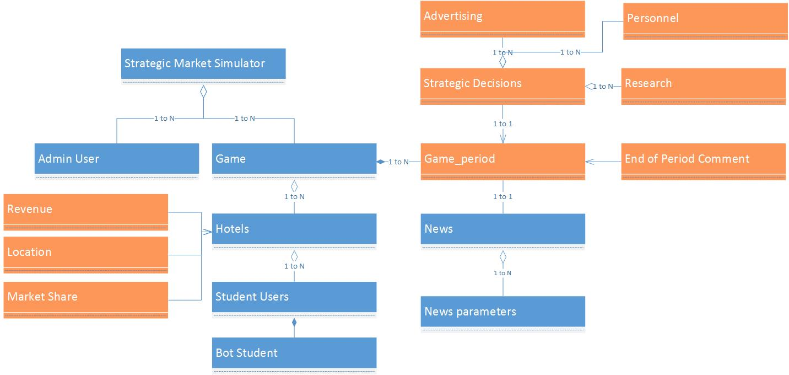
Minimal Class Diagram
Notes:
6. Detailed design:
6.1. Minimal class diagram. Identify the design patterns used (one or more slides).
6.2. State machine for the main control object or the most important object of the implemented uses cases (one or more slides).
6.3. Main algorithm used related to an implemented use case described above (one or more slides).

Slide 12
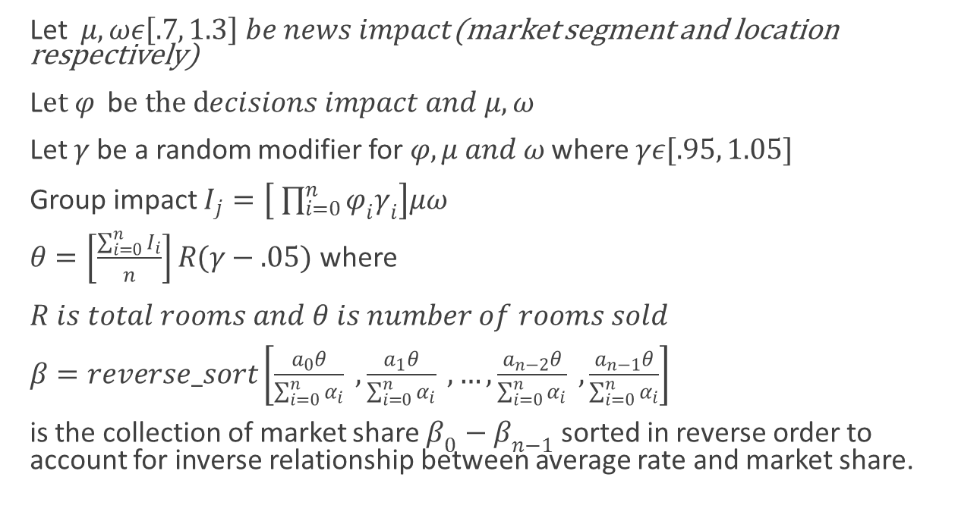
Main algorithm
Let $μ,ωε\left[.7, 1.3\right] be news impact$(market segment and location respectively)
L$et φ$b$e the decisions impact and μ,ω$
Let $γ$ be a random modifier for $φ,μ and ω$ where $γε[.95, 1.05]$
Group impact $I_{j}=\left[ \prod_{i=0}^{n}{φ_{i}γ_{i}}\right]μω$
$θ=\left[\frac{\sum_{i=0}^{n}{I_{i}}}{n}\right]R(γ−.05)$ where
$R is total rooms and θ is number of rooms sold$
$β=reverse_sort\left[\frac{a_{0}θ}{\sum_{i=0}^{n}{α_{i}}} , \frac{a_{1}θ}{\sum_{i=0}^{n}{α_{i}}} , …,\frac{a_{n−2}θ}{\sum_{i=0}^{n}{α_{i}}} , \frac{a_{n−1}θ}{\sum_{i=0}^{n}{α_{i}}}\right]$
is the collection of market share $β_{0}−β_{n−1}$ sorted in reverse order to account for inverse relationship between average rate and market share.
Notes:
6. Detailed design:
6.1. Minimal class diagram. Identify the design patterns used (one or more slides).
6.2. State machine for the main control object or the most important object of the implemented uses cases (one or more slides).
6.3. Main algorithm used related to an implemented use case described above (one or more slides).

Slide 13
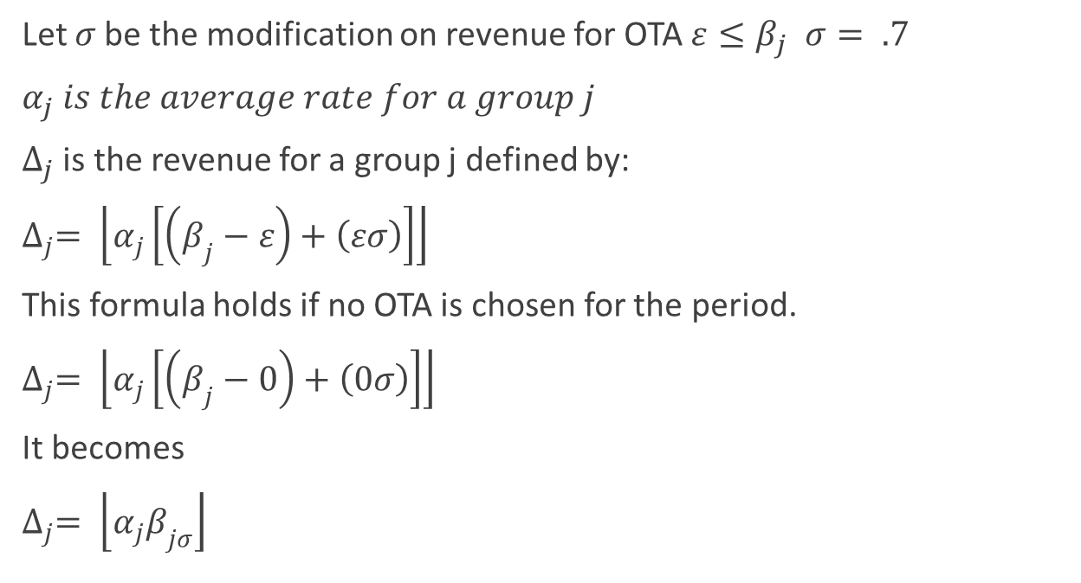
Main algorithm
Let $σ$ be the modification on revenue for OTA $ε≤β_{j}$ $σ= .7$
$α_{j}$ $is the average rate for a group j$
$∆_{j}$ is the revenue for a group j defined by:
$∆_{j}= \left\lfloor α_{j}\left[\left(β_{j}−ε\right)+\left(εσ\right)\right]\right\rfloor$
This formula holds if no OTA is chosen for the period.
$∆_{j}= \left\lfloor α_{j}\left[\left(β_{j}−0\right)+\left(0σ\right)\right]\right\rfloor$
It becomes
$∆_{j}= \left\lfloor α_{j}β_{jσ}\right\rfloor$
Notes:
6. Detailed design:
6.1. Minimal class diagram. Identify the design patterns used (one or more slides).
6.2. State machine for the main control object or the most important object of the implemented uses cases (one or more slides).
6.3. Main algorithm used related to an implemented use case described above (one or more slides).

Slide 14
Test Suites and Test Cases
PHPUnit
Test ID: | Student_Strategic_Decision_ Sunny_Day_112
Test Purpose | Test Student Strategic Decisions Commit decisions for sunny day
Test setup | System displays Strategic Decisions page to user
Inputs | Room Price: 80
 | Direct Marketing Checkbox selected
 | TV SPot Checkbox selected
 | City Bus Checkox selected
 | Entry Level : 1
Expected output: | The system navigates the user the the homepage and updates the Strat_decisions table in the database
Notes:
7. Test Suites and Test Cases (one sunny day and one rainy day) for the use case represented in part (5) above (2 slides).
7.1 One sunny day and one rainy day for the implemented use cases (one or more slides).
7.2 Automated test scripts for the implemented use cases (one or more slides).

Slide 15
Test Suites and Test Cases
Test ID: | Student_Strategic_Decision_ rainy_Day_112
Test Purpose | Test Student Strategic Decisions Commit decisions for rainy day
Test setup | System displays Strategic Decisions page user
Inputs | Room Price: 80
 | Direct Marketing Checkbox selected
 | TV SPot Checkbox selected
 | Entry Level : 1
Expected output: | System returns validates the input and display the message: "Please select at least three advertising decisions".

Slide 16
Summary
Strategic Marketing Simulator 1.0 was developed using the MVC design pattern with the purpose of creating and interactive hotel sales marketing simulation.
contact information:
Jeffrey Carman
jcarman@dataonacid.com
Questions?
Thank You!
Notes:
Summarize your contribution
Include your contact information
Ask if anyone has any questions for you.
Thank your audience

